Slide 1
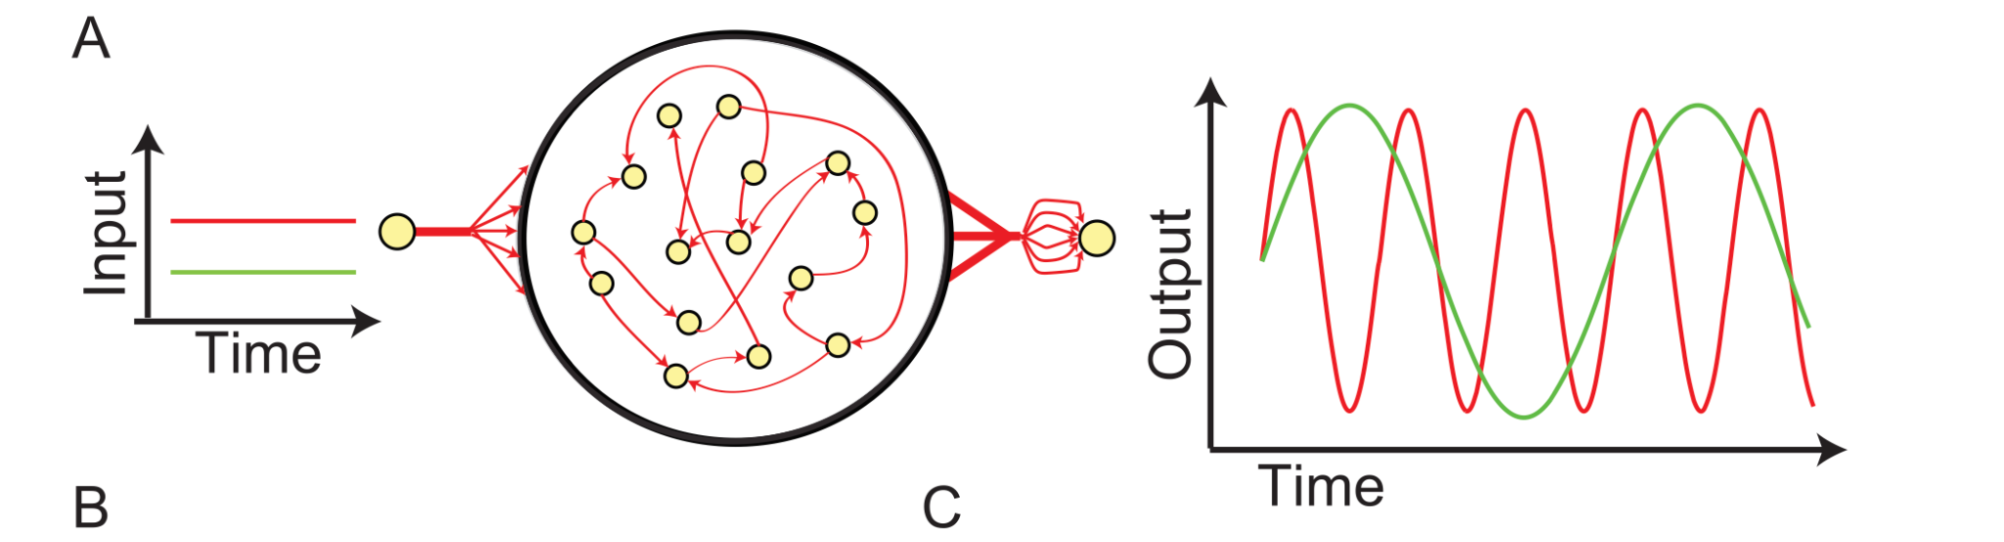
Task
I trained a recurrent neural network (RNN) on the sine wave generator task.
Sussillo & Barak, Neural Computation (2013)
This task involves giving the RNN a static input and transforming that input into a frequency. The RNN then outputs a sine wave with that frequency.

Slide 2
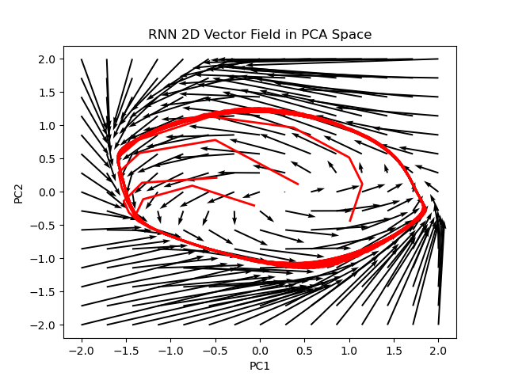
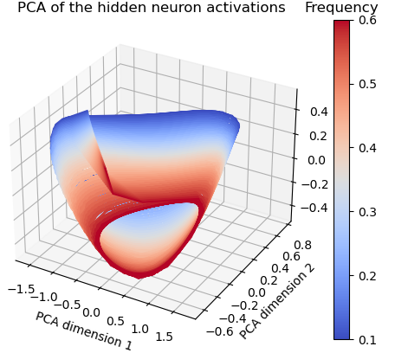
Results
We choose to analyze the trained RNN with the dynamical view.
The network learned a limit cycle.
However, we would like to note that the manifold view could apply.
The network learned a manifold of limit cycles.
In order to readout different sine waves, the input would drive the RNN to a new point on the manifold.

